Slide 1
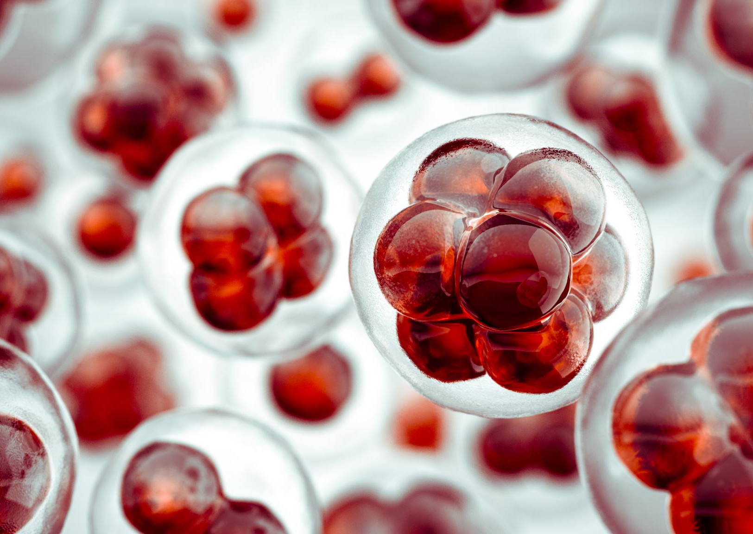
What Single-Cell Data Is
Teaching Us About
Cancer Evolution
From curiosity to cancer insight
one cell at a time.

Slide 2
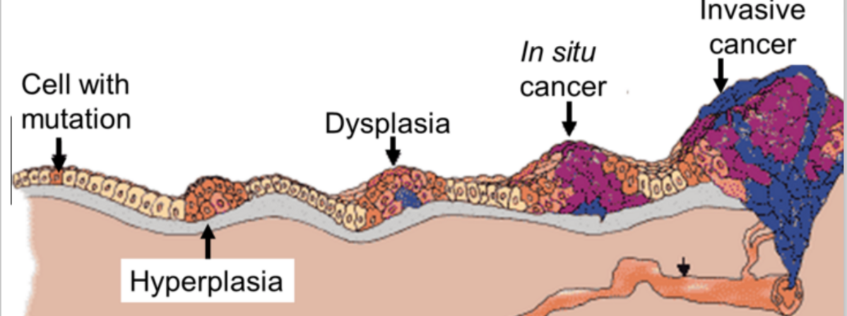
Source: 12
Cancer as a Living, Evolving System
Cancer isn’t just a lump of cells.
It’s a dynamic ecosystem: tumor cells, immune cells, and stroma all talking, competing, and adapting [5].
Single-cell data lets us peek cell by cell [3].

Slide 3
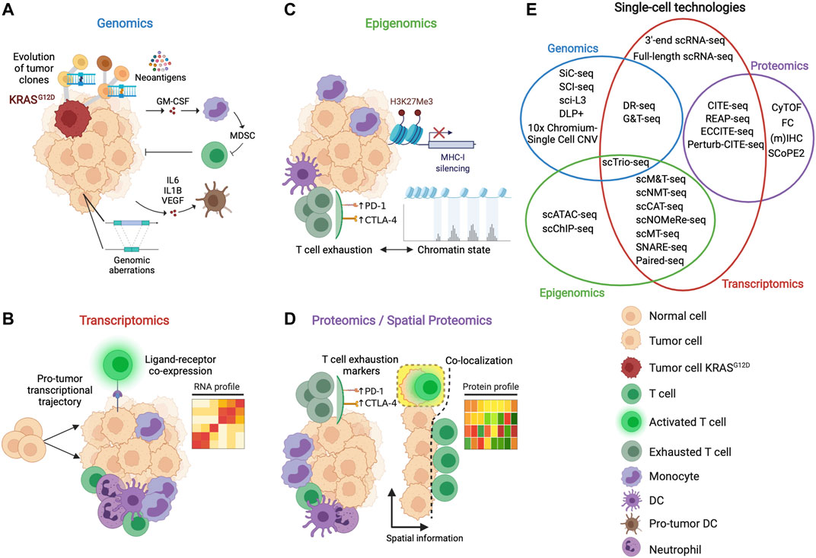
Tumour Diversity (Heterogeneity)
Every tumor is unique.
Some cells divide fast, some sleep, some hide from therapy.
This diversity drives evolution – the more diverse, the harder it is to treat [6].
scRNA-seq lets us map all these cell types in one tumour [3].
Source: 4

Slide 4
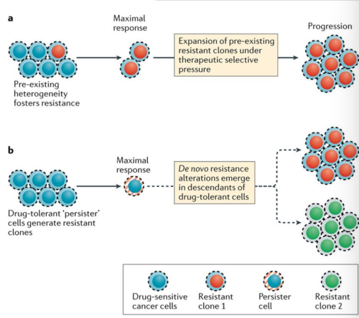
How Tumours Resist Therapy
Resistance isn’t just mutations – it’s flexible, adaptive behaviour.
Cells can switch identity (plasticity) to survive stress [9].
Some hide in dormancy, some reprogram metabolism [11].
Even the immune system gets tricked – tumours build protective niches [10].
Source: 7

Slide 5
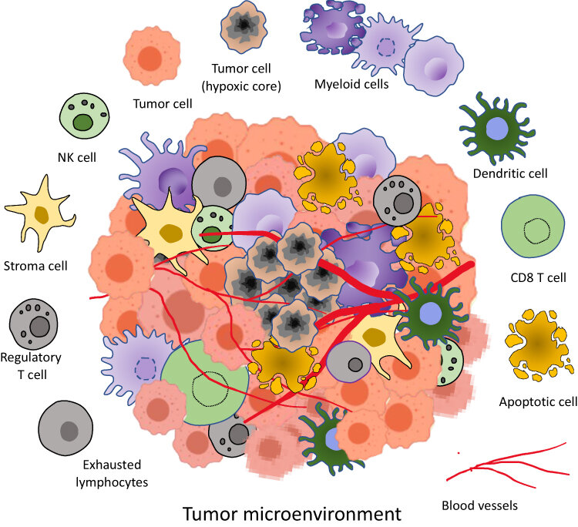
Tumour Microenvironment: The Neighbourhood
Tumours don’t grow alone – they live in a neighbourhood of immune and stromal cells.
scRNA-seq shows:
  Exhausted immune cells
  Supportive fibroblasts
  Molecular conversations (ligand-receptor interactions)
Cancer evolves together, not in isolation [8].
Source: 1

Slide 6
Single-cell data helps:
Spot rare cells driving relapse
Map tumour interactions
Predict how cancers might adapt
Future: AI, spatial maps, personalized therapy.
Takeaway: Cancer is alive, adaptable, and collaborative – understanding it cell by cell is game-changing.
Why This Matters & What’s Next

Slide 7
REFERENCES
Allemailem, K.S., Alsahli, M.A., Almatroudi, A., Faris Alrumaihi, Waleed Al Abdulmonem, Moawad, A.A., Alwanian, W.M., Nahlah Makki Almansour, Arshad Husain Rahmani and Amjad Ali Khan (2023). Innovative Strategies of Reprogramming Immune System Cells by Targeting CRISPR/Cas9-Based Genome-Editing Tools: A New Era of Cancer Management. International Journal of Nanomedicine, Volume 18, pp.5531–5559. doi:https://doi.org/10.2147/ijn.s424872.
Alessandro Ottaiano, Ianniello, M., Mariachiara Santorsola, Ruggiero, R., Sirica, R., Sabbatino, F., Perri, F., Cascella, M., Massimiliano Di Marzo, Berretta, M., Caraglia, M., Nasti, G. and Savarese, G. (2023). From Chaos to Opportunity: Decoding Cancer Heterogeneity for Enhanced Treatment Strategies. Biology, 12(9), pp.1183–1183. doi:https://doi.org/10.3390/biology12091183.
Bridges, K. and Miller-Jensen, K. (2022). Mapping and Validation of scRNA-Seq-Derived Cell-Cell Communication Networks in the Tumor Microenvironment. Frontiers in Immunology, 13. doi:https://doi.org/10.3389/fimmu.2022.885267.
Caligola, S., Francesco De Sanctis, Canè, S. and Stefano Ugel (2022). Breaking the Immune Complexity of the Tumor Microenvironment Using Single-Cell Technologies. Frontiers in Genetics, 13. doi:https://doi.org/10.3389/fgene.2022.867880.
Chen, X. and Song, E. (2022). The theory of tumor ecosystem. Cancer communications, [online] 42(7), pp.587–608. doi:https://doi.org/10.1002/cac2.12316.
Colonna, G. (2025). Overcoming Barriers in Cancer Biology Research: Current Limitations and Solutions. Cancers, [online] 17(13), pp.2102–2102. doi:https://doi.org/10.3390/cancers17132102.
Dagogo-Jack, I. and Shaw, A.T. (2018). Tumour heterogeneity and resistance to cancer therapies. Nature Reviews Clinical Oncology, [online] 15(2), pp.81–94. doi:https://doi.org/10.1038/nrclinonc.2017.166.
de Visser, K.E. and Joyce, J.A. (2023). The evolving tumor microenvironment: From cancer initiation to metastatic outgrowth. Cancer Cell, [online] 41(3), pp.374–403. doi:https://doi.org/10.1016/j.ccell.2023.02.016.
Nikolaou, S. and Machesky, L.M. (2020). The stressful tumour environment drives plasticity of cell migration programmes, contributing to metastasis. The Journal of Pathology, 250(5), pp.612–623. doi:https://doi.org/10.1002/path.5395.
Phei Er Saw, Liu, Q., Wong, P.-P. and Song, E. (2024). Cancer stem cell mimicry for immune evasion and therapeutic resistance. Cell stem cell, [online] 31(8). doi:https://doi.org/10.1016/j.stem.2024.06.003.
Wang, Y., Liu, L., Zhang, X., Liang, T. and Bai, X. (2025). Cancer dormancy and metabolism: From molecular insights to translational opportunities. Cancer Letters, [online] 635, p.218097. doi:https://doi.org/10.1016/j.canlet.2025.218097.
WikiMedia Commons (2017). File:צילום מסך 2017.07.14 ב.21.42.55.png - Wikimedia Commons. [online] Wikimedia.org. Available at: https://commons.wikimedia.org/wiki/File:%D7%A6%D7%99%D7%9C%D7%95%D7%9D_%D7%9E%D7%A1%D7%9A_2017.07.14_%D7%91.21.42.55.png [Accessed 1 Nov. 2025].

